Slide 1
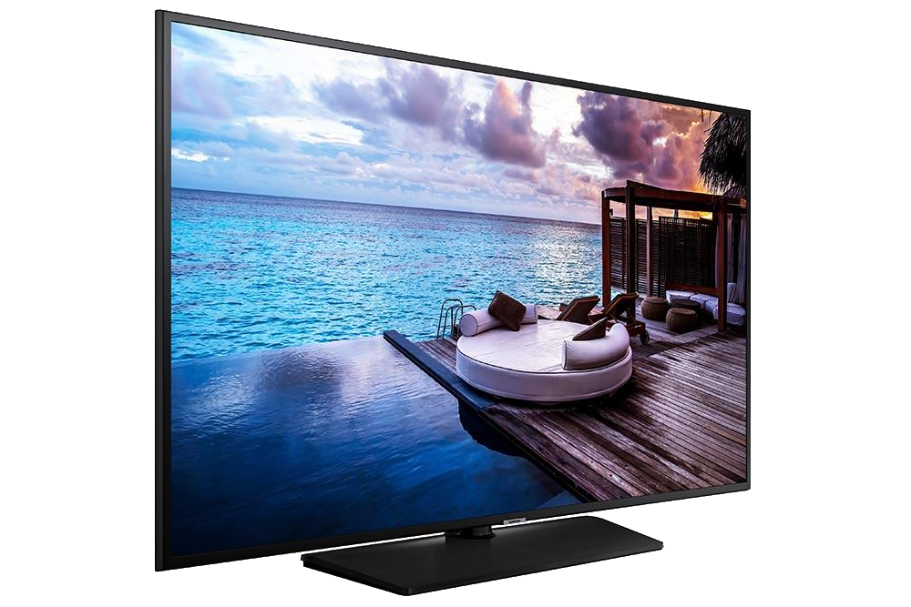
Samsung LYNK Cloud Project creation

Slide 2
Project Module
Table of contents:
PROJECT IN LYNK CLOUD
CREATE NEW PROJECT
BASIC SETUP
HOME PAGE:
HOME PAGE CREATION
HOME PAGE CUSTOMIZATION
MENU
SUBPAGES:
CREATE ARCHIVE PAGE (Archive template)
CREATE SINGLE PAGE (Elementor)
CREATE TV CHANNEL PAGE
CREATE E-COMMERCE PAGE
CONTENT TYPES:
CREATE POSTS
CREATE TV CHANNELS
CREATE CONTENT CATEGORIES
CREATE CONTENT TYPES
CSS EDITOR
TRANSLATE MANAGER
Notes:
4 templates

Slide 3
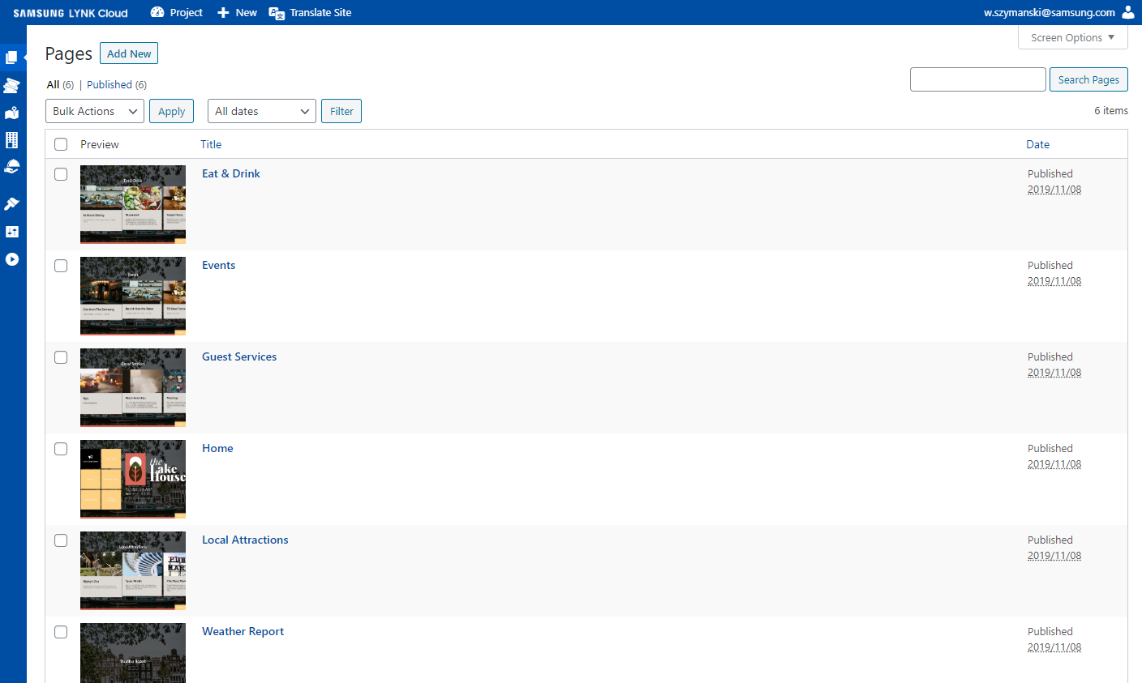
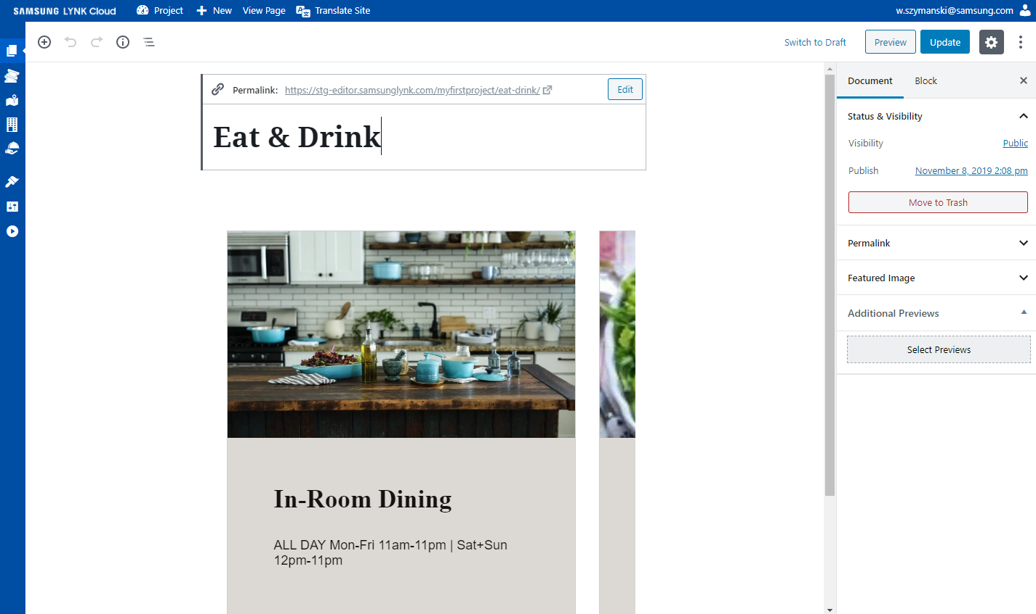
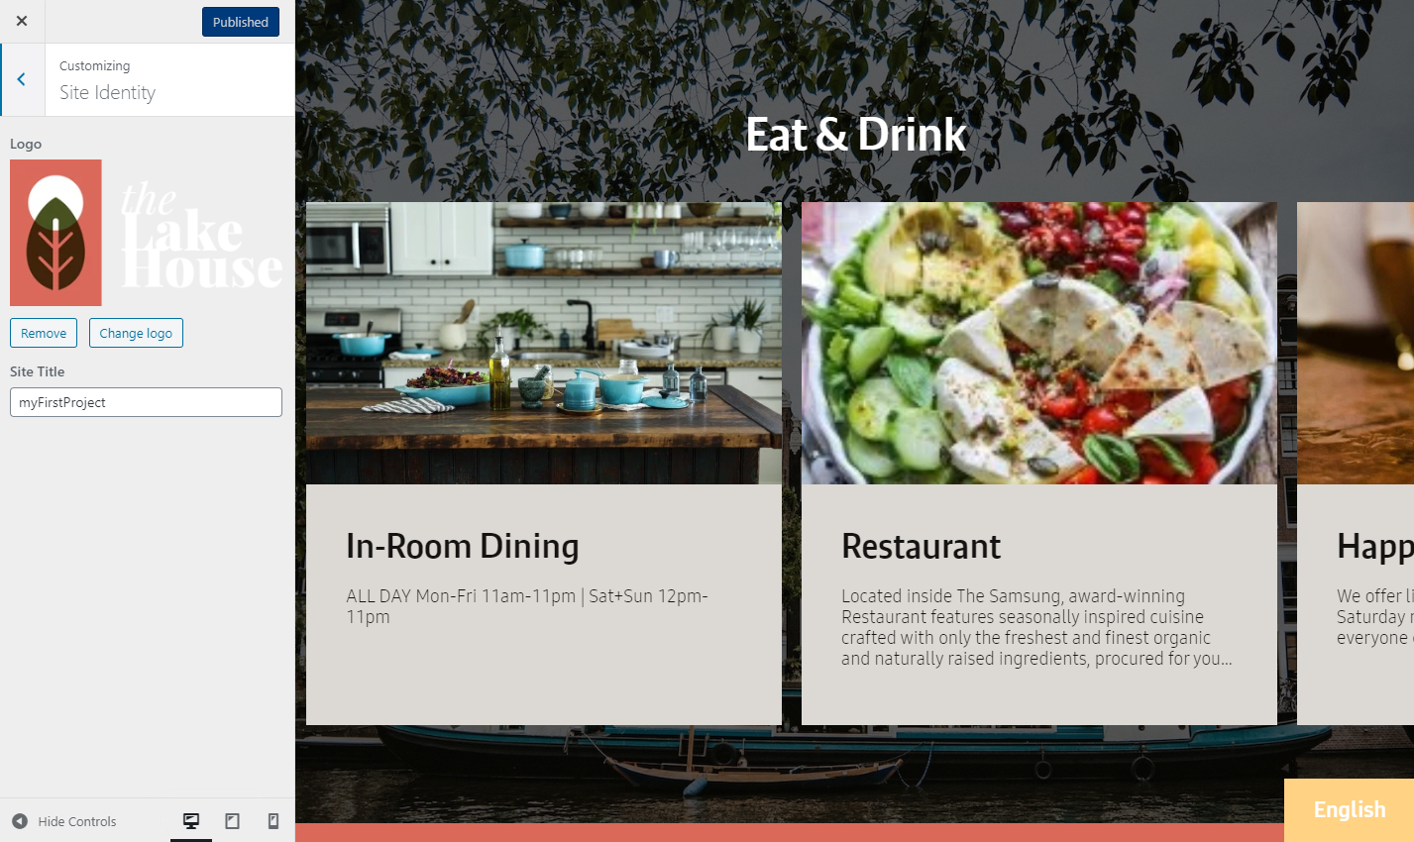
Project
Project in Lynk Cloud is a HTML based web application stored on Lynk Cloud servers.
Create new or use one of available themes for
project using WordPress CMS editor.
All media files (Videos, Audios, Images etc…) and all content is stored in the cloud, once project is deployed TV receives only permalinks to each page.
Project don’t have to be deployed each time it’s
changed.
Publishing in WordPress CMS editor and restarting Hotel App will apply changes.
Each project page can be viewed/navigated/ edited live in web browser on a server site.
Notes:
4 templates

Slide 4
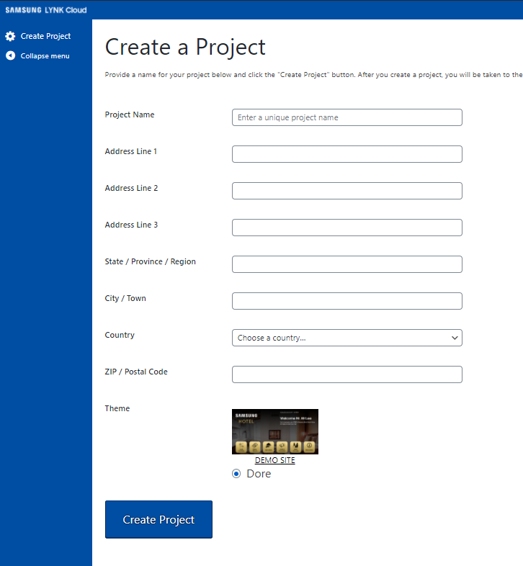
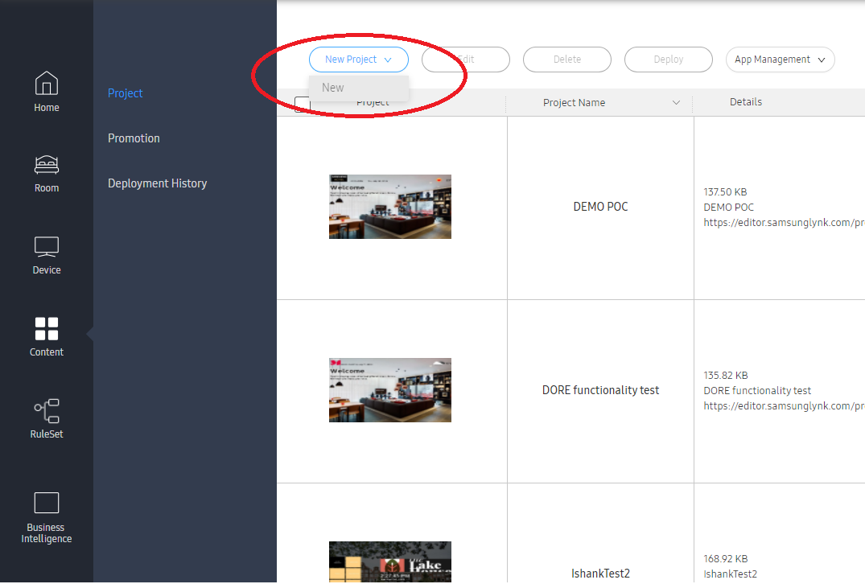
Create new Project
Go to “Content” -> “Project -> “New
Before you start customization, provide basic information about project (Name, Location, Theme).
Location is crucial for Weather Information Widget.
Notes:
4 templates

Slide 5
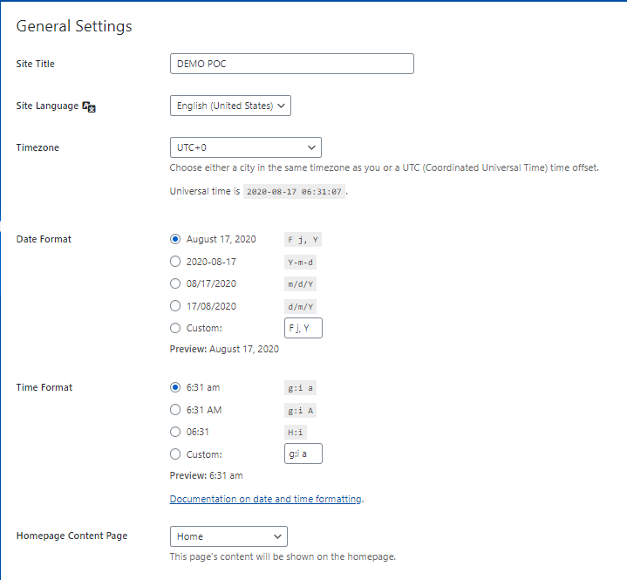
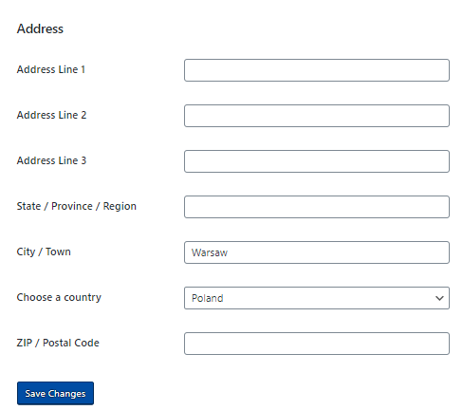
Basic Setup
Go to Settings -> General, select the correct language for the Site, Time zone, Date and time formats, address and save the changes.
Notes:
What about the widgets, and tv control function? Will be added in 1.1 but where in the project it will be avialbale?
Language available in 1.0: EN – ES
Widgets:
Weather info – available
TV channel library
VOD library
OTT apps integration
TV control integration (menu options)

Slide 6
Create Home page
Go to Pages -> Add new, give your newly created page a title (i.e. “Home”). And publish.
Then go to Settings -> General, and select the page in the “Homepage Content Page”.
From now the Page “home” is considered the starting point of the project and all “Homepage” features are assigned to it.
Notes:
What about the widgets, and tv control function? Will be added in 1.1 but where in the project it will be avialbale?
Language available in 1.0: EN – ES
Widgets:
Weather info – available
TV channel library
VOD library
OTT apps integration
TV control integration (menu options)

Slide 7
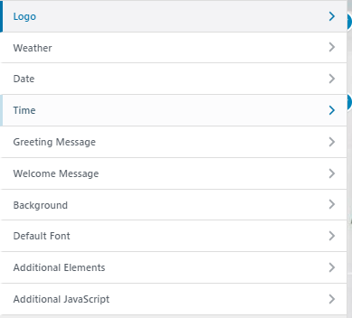
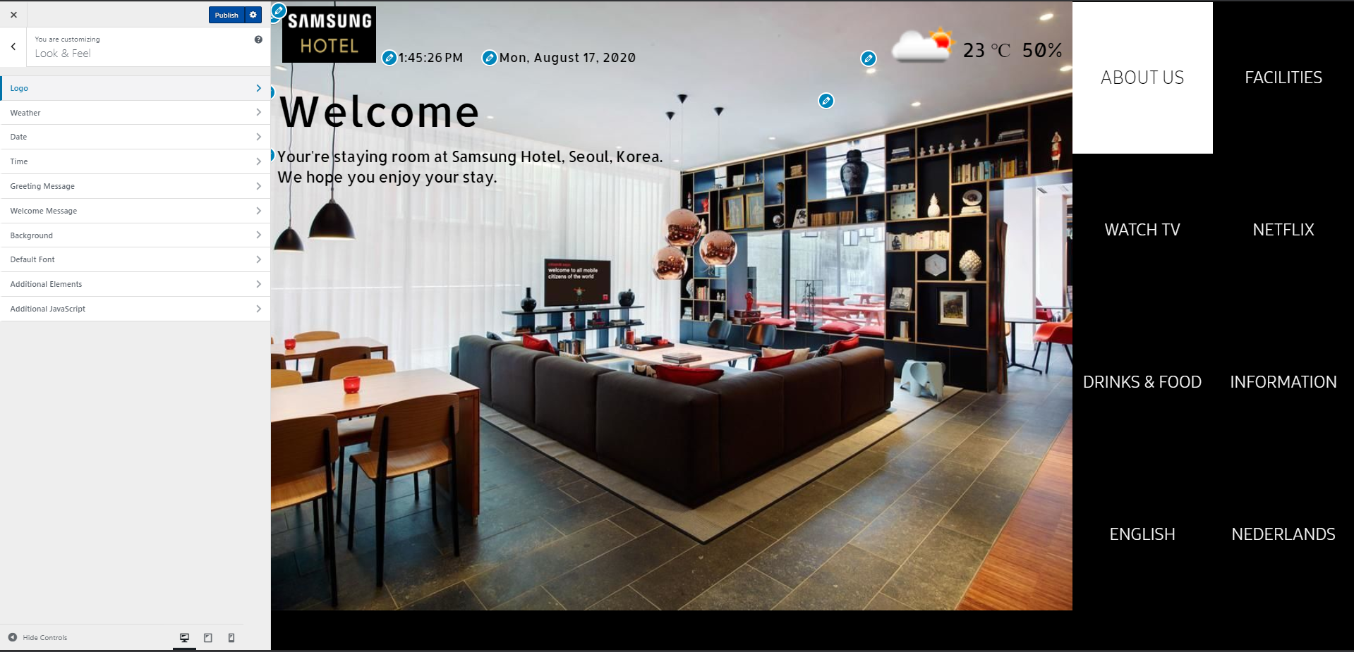
Customize Home page
Go to Appearance -> Customize-> Look & Feel
Adjust settings of all Homepage widgets:
Notes:
What about the widgets, and tv control function? Will be added in 1.1 but where in the project it will be avialbale?
Language available in 1.0: EN – ES

Slide 8
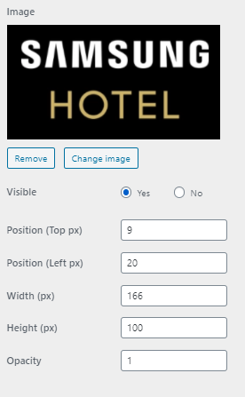
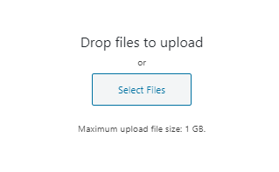
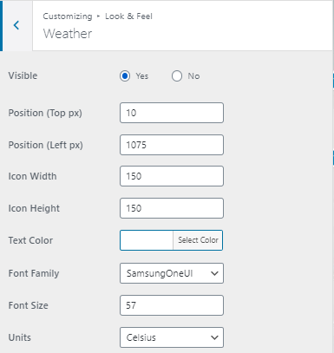
Customize Home page
Logo: Adjust size and position. Change logo with Change image. Drag and drop file from desktop, no larger than 1GB.
Weather: Adjust size and position of weather widget. Set the units, font and color. The data will be presented basing on the location info from general settings menu.
Notes:
What about the widgets, and tv control function? Will be added in 1.1 but where in the project it will be avialbale?
Language available in 1.0: EN – ES

Slide 9
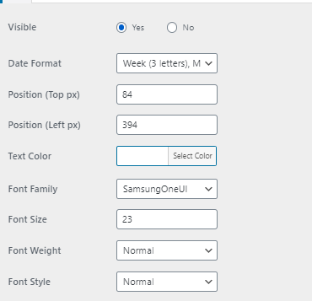
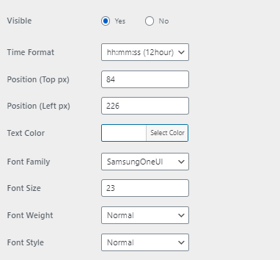
Customize Home page
Date: Make sure to select correct Date format. You can also adjust the color, fonts, sizes and position of the widget.
Time: Make sure to select correct time format. You can also adjust the color, fonts, sizes and position of the widget.
Notes:
What about the widgets, and tv control function? Will be added in 1.1 but where in the project it will be avialbale?
Language available in 1.0: EN – ES

Slide 10
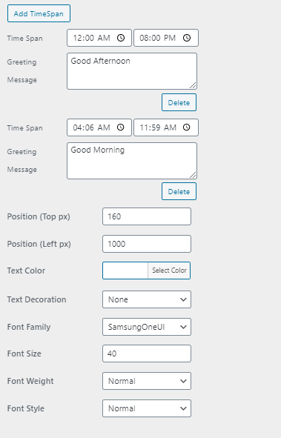
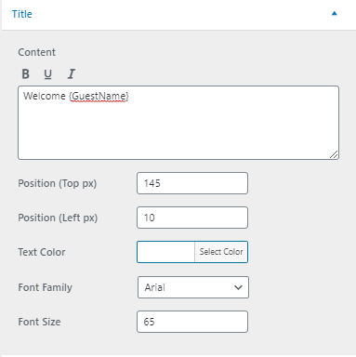
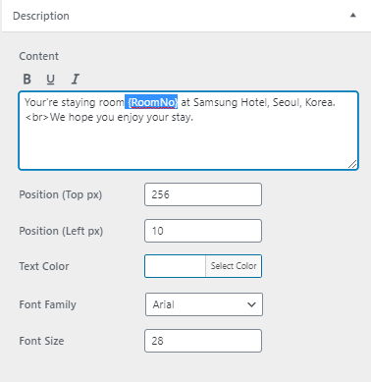
Customize Home page
Welcome Message: You can create a personalized message for you guest. {GuestName} and {RoomNo} will be replaced with guest info collected during Check-in.
Greeting message: Greeting message can be changed basing on the time. In order to add different greeting messages, click on Add TimeSpan, specify the time and the message which should be displayed.
Notes:
What about the widgets, and tv control function? Will be added in 1.1 but where in the project it will be avialbale?
Language available in 1.0: EN – ES

Slide 11
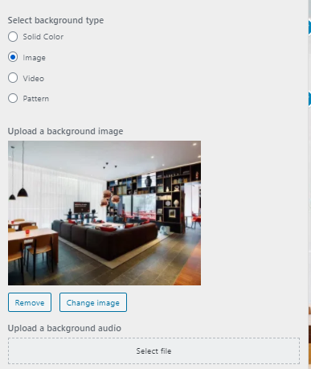
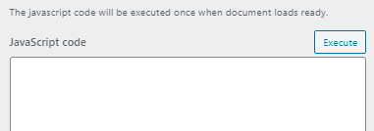
Customize Home page
Background: Specify type of background (the background will be set globally on all pages except those created in Elementor).
Upload file (1 GB maximum).
Upload background audio if needed.
Default font: Specify default font family for the whole project (fonts for all abject can be adjusted separately in CSS editor).
Custom Elements: You can add additional text, images and custom HTML elements.
Custom JavaScript: Execute custom JS scripts anytime Page reloads.
Notes:
What about the widgets, and tv control function? Will be added in 1.1 but where in the project it will be avialbale?
Language available in 1.0: EN – ES

Slide 12
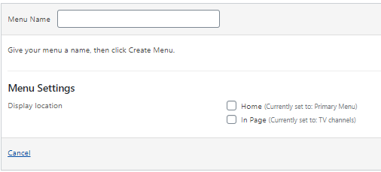
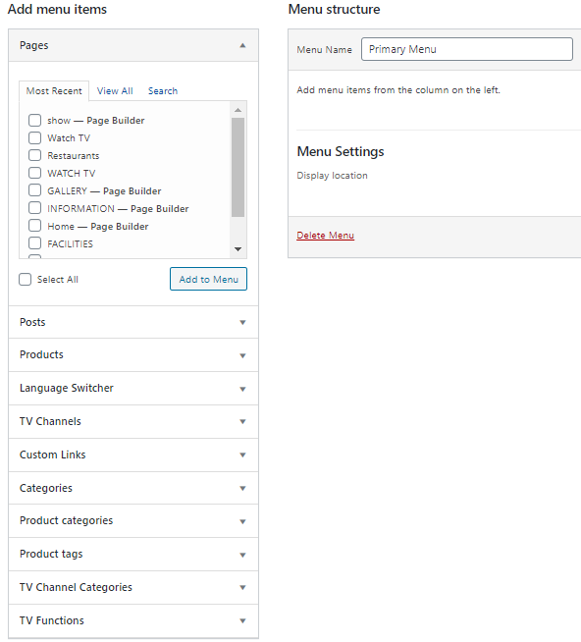
Menu Creation
You can create menus in Appearance -> Menus. In order to create Home menu, hit create a new menu, give it a name and select a Display location to “Home”.
In order to add sections to the menu, just select section from the menu on the left side (it lists all sections of your project, Pages, Posts, Products, TV channels, TV functions etc…) and select ADD TO MENU.
Notes:
What about the widgets, and tv control function? Will be added in 1.1 but where in the project it will be avialbale?
Language available in 1.0: EN – ES

Slide 13
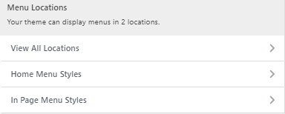
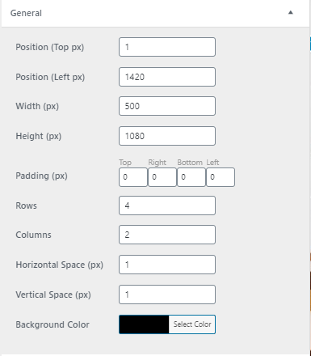
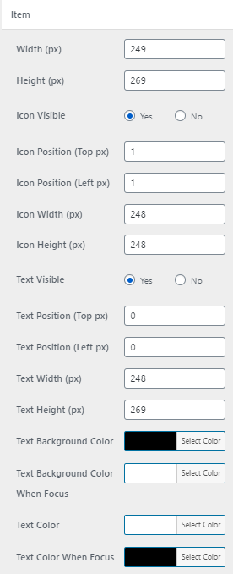
Menu Customization
In order to customized the created Home menu go to Appearance -> Customize and select Menus. Then proceed to Home Menu styles section.
In the section General you can change the style settings of the general Menu area (size, color, number of rows and columns).
In the section Item you can adjust the style of each Menu section (each section reflects sections of projects and TV functions added to the menu). You can specify their sizes (need to be adjusted dependently on the settings of the general area) colors, fonts etc…
Notes:
What about the widgets, and tv control function? Will be added in 1.1 but where in the project it will be avialbale?
Language available in 1.0: EN – ES

Slide 14
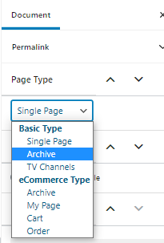
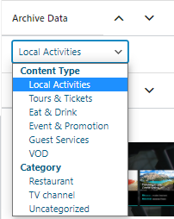
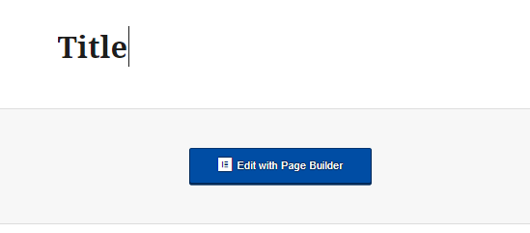
Create Archive Page
Archive pages allow you to store Posts and content from predefined category and visualize them in a form of content carousel.
Go to Pages -> Add New, add title to the page. Then select Archive in Page Type section.
Select the Type of data you want to store in the page, based on Content type or category.
From now on all posts with the selected category/content type will be visible on this page in the from of content carousel.
Notes:
What about the widgets, and tv control function? Will be added in 1.1 but where in the project it will be avialbale?
Language available in 1.0: EN – ES

Slide 15
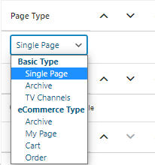
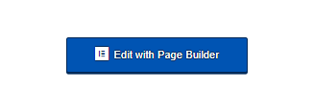
Create Single Page
Single pages are stand alone pages that you can create from blank canvas, fully customize the style and include number of interactive features.
Go to Pages -> Add New, add title to the page. Then select Single Page in Page Type section.
Single pages can only be edited with Elementor, after you specify the page type go to Edit with Page Builder in order to start the editing.
Notes:
What about the widgets, and tv control function? Will be added in 1.1 but where in the project it will be avialbale?
Language available in 1.0: EN – ES

Slide 16
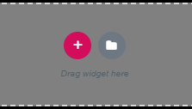
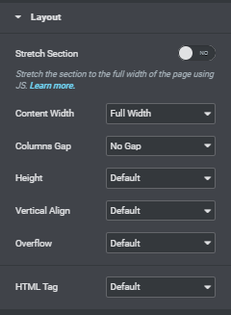
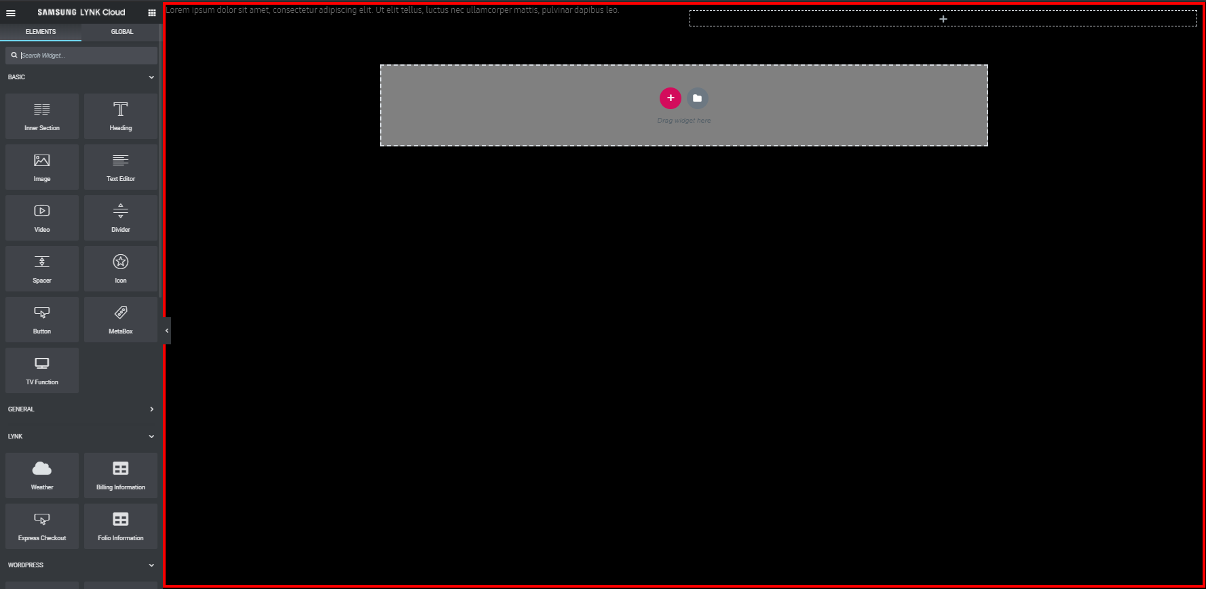
Elementor
Elementor is a Page builder plug in to Wordpress. It allows you to create HTML content starting from blank canvas, by just dividing the page into sections and drag and drop widgets.
In order to add section just click on Plus icon and select the desired structure of the section. Then specify all layout settings of the section, and proceed to Widget Section.
You can add as many sections as you need to a project. Also each section can hold as many widgets as you want.
Red boarder indicates the borders of TV screen, do not ceate content outside of those borders.
Widget section
Notes:
What about the widgets, and tv control function? Will be added in 1.1 but where in the project it will be avialbale?
Language available in 1.0: EN – ES

Slide 17
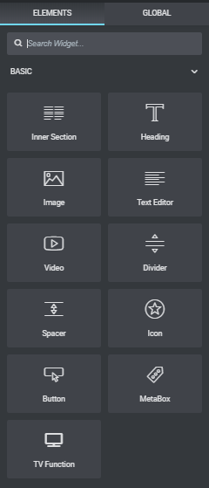
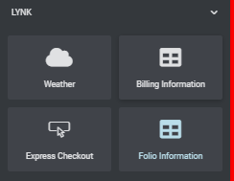
Elementor
Widget space is divided into categories:
Basic gives you all basic HTML ellements, along with additional TV functions widget (Change channel, source or open application).
General gives you more complex HTML elements like Image galleries, Content carousels and custom HTML elements.
Lynk gives you widgets that use Lynk Cloud functionalities like Express check out button, billing information etc…
In order to Preview the project go to left side menu and at the very bottom click on “eye” icon.
In order to publish all the changes hit the Publish green button.
Notes:
What about the widgets, and tv control function? Will be added in 1.1 but where in the project it will be avialbale?
Language available in 1.0: EN – ES

Slide 18
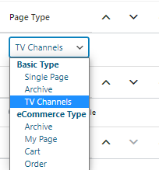
TV channels page
In Lynk Cloud project you can store your TV channels either as a Menu tile, or in a designated page. In order to create such page go to -> Pages -> New page, give it a title (i.e. Watch TV) and select category TV channels.
TV channels Page will list all TV channels added to TV channel library. Page includes:
Logo
Date/Time widget
Navigation menu
Predefined layout and each element can be adjusted and customized in CSS editor.
Notes:
What about the widgets, and tv control function? Will be added in 1.1 but where in the project it will be avialbale?
Language available in 1.0: EN – ES

Slide 19
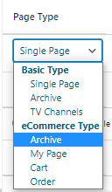
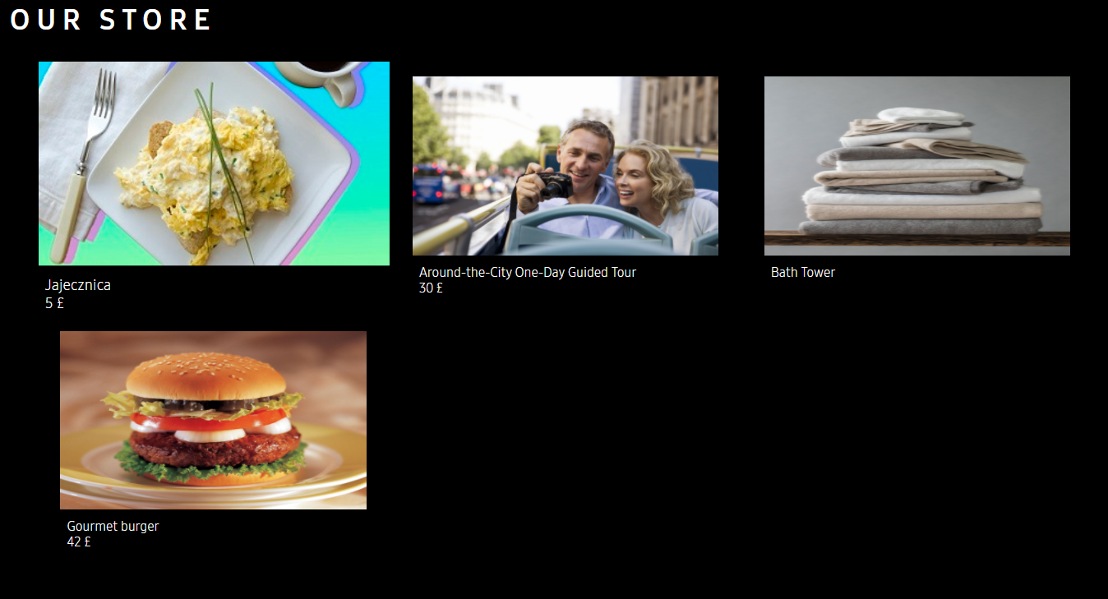
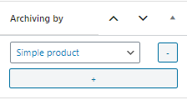
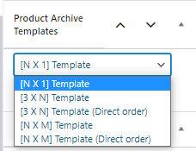
E-commerce Page
Lynk Cloud gives you possibility to setup your own E-commerce system within your Site.
Create an Archive E-commerce page to list all your products, go to Pages -> Add new, and select Page type to eCommerce type -> Archive.
You can set the Products which you want to display in the page in Archive by tab, select which Product Type, category or tag. You can add multiple positions by click “+” button.
You can also setup a Archiving template, dependently on how many Rows or Columns you wish to have.
Fully customizable Main E-Commerce page will be setup automatically, listing all products from selected categories/types/Tags with the selected layout.
Notes:
What about the widgets, and tv control function? Will be added in 1.1 but where in the project it will be avialbale?
Language available in 1.0: EN – ES

Slide 20
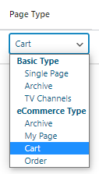
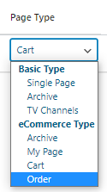
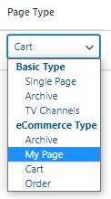
Cart, order and mypage
In order to setup a working E-Commerce system you will need also the Cart and Orders pages, or if you want to combine the two you can create “My page”.
Go to Pages -> Add new, and select Page type to eCommerce type -> Cart.
Cart lists all products “added to cart” by customer, they can be ordered at once from the Cart view.
Go to Pages -> Add new, and select Page type to eCommerce type -> Order.
On the order page your clients can view all their orders with the status.
Go to Pages -> Add new, and select Page type to eCommerce type -> My Page.
My page combines both “cart” and “order” pages.
Notes:
What about the widgets, and tv control function? Will be added in 1.1 but where in the project it will be avialbale?
Language available in 1.0: EN – ES

Slide 21
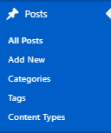
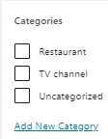
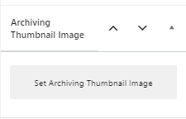
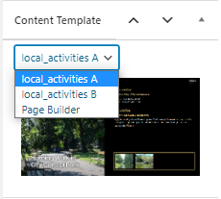
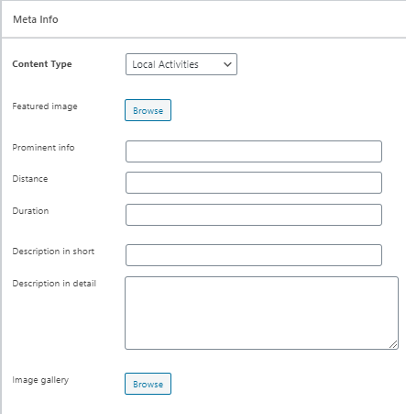
Posts
In Lynk Cloud Posts are considered Subpages that can be all gathered and listed in an archive page. Posts can be divided by the default or newly created categories, content types and additional tags.
In order to start adding new posts got to Posts section and click “Add new”.
The first thing you want to do is add a title, then go to the menu on the right side to add additional info:
Category.
Add Archiving image (the one visible on the small thumbnail once post is on Archive page).
Select a layout template or Page builder if you want to create post from blank canvas.
Add a Preview image (the one visible once the post is highlighted)
Select whether or not you want the In-page menu added to the post.
Finally go to Meta Info (of you selected a default template) and fill out the form (it will differ from category to category) to add all elements of your post.
For preview go to upper right section and click:
Notes:
What about the widgets, and tv control function? Will be added in 1.1 but where in the project it will be avialbale?
Language available in 1.0: EN – ES

Slide 22
Content categories
In Lynk Cloud you can easily categorize the Posts with the usage of content categories.
In order to create category go to Posts -> Categories. You will be redirected to the page that lists al of the content categories in your project. If you want to add a new category for example: “Rest and Relax” for all attractions associated with wellness and relax like Spa or water pool. Add its title, then setup a hierarchy (if your category is to be a parent category just leave none). And add description. Once you click Add new Category button, the category will be added to the list and you will be able to use in the Post creation menu.
Notes:
What about the widgets, and tv control function? Will be added in 1.1 but where in the project it will be avialbale?
Language available in 1.0: EN – ES

Slide 23
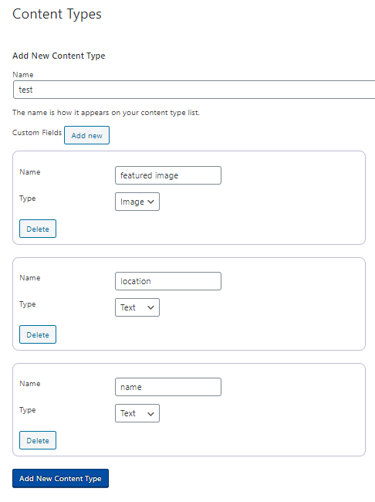
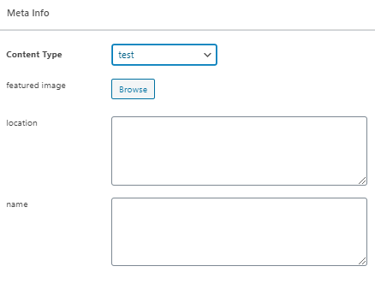
Content types
There are several predefined Content Types in Lynk Cloud:
Local activities
Tours & Tickets
Eat & Drink
Events & Promotions
Products
Guest services
VOD
Content type defines what kind of information can be included in the Post. For example there are different info that you want to put in the Restaurant post (like sample menu and open/close hours) and different for recreational activates (like, price and location of the activity). You can use the existing content type or you can create your own. In order to create a custom content type go to Posts -> Content types.
You will be presented with the list of all Content types created by you. In the section Add New content Type insert the name (for example : “Restaurants”), then add new Custom field, give it a name (for example: “description”) and specify whether it is a text field or image, you can add as many custom fields as you want.
Once the type is saved, you can use it when creating the post. Once you go to Posts -> Add new and select the content type category you created, you will only have to fill in the fields hat you have specified for this content type.
Content type creation
Creation of the post with the newly created content type
Notes:
What about the widgets, and tv control function? Will be added in 1.1 but where in the project it will be avialbale?
Language available in 1.0: EN – ES

Slide 24
TV channels
In order to add actual TV channels to the TV channels page or to the menu, you need to create the channel list in the project first.
Firstly, make sure that all the channels are mapped on the TV, in order to know all the channel numbers. Once that is done, go to:
Project main dashboard -> TV channels -> All TV channels
You will be redirected to the page listing all channels, in order to create new channels click on “Add new” button.
You will be presented a form, first fill in the “Title” section, this will only set the “name” of the channel visible in the project it will not change the channel name on TV.
Then fill in the “TV Channel Number” field, with the channel number on which the channel you are adding is tuned to on the TV.
After specifying channel number upload the Icon, this con will only be visible on the project level, it will not affect the way the channel is visible on the TV.
Lastly, select the category for your channel. If there are no TV channel categories yet in your project , you can easily add them by clicking on “Add New Category”. If you do not want TV channel categories you can just ignore this field.
In order to save the added channel click on the:
Notes:
What about the widgets, and tv control function? Will be added in 1.1 but where in the project it will be avialbale?
Language available in 1.0: EN – ES

Slide 25
CSS editor
SCC editor is Wordpress plug-in that allows you to add custom CSS settings for every page and element of your project.
In order to start CSS editing, go to Appearance - > CSS editor. You will be redirected to the CSS editor preview page. There will be a pop up window in which you need to specify which page of the project you want edit and whether you want the settings to be implement only to that site (Single) or globally (Global). Click “Continue” to proceed to the CSS editor.
Notes:
What about the widgets, and tv control function? Will be added in 1.1 but where in the project it will be avialbale?
Language available in 1.0: EN – ES

Slide 26
CSS editor
CSS editor gives you full live preview of the page you are working on alogn with two separate menus:
Navigation menu -> On the left side you find a set of functions that include:
Element inspector – Control the way you inspect the side
CSS editor – Edit CSS manually
Responsive mode –Select type of screen you will edit for
Ruler – Measurement device
Animation manager – Easily manage your animations
2. Settings menu -> Floating window, by default on the right side
Settings menu gives you possibility to individually adjust all the settings of the selected element like:
Text (Fonts, colors, highlights etc…)
Background (images, colors etc…)
Margins
Paddings
Positions
Many more
Notes:
What about the widgets, and tv control function? Will be added in 1.1 but where in the project it will be avialbale?
Language available in 1.0: EN – ES

Slide 27
Translate manager
Translate manager allows you to create store and manage the localized versions of your project.
In order to specify the languages to which you want to translate go to Settings -> TranslatePress.
Select the Deafult language, add all languages in All Languages section. Specify if you want to display Lang names in Native lang or in English.
There are three ways to create navigation for Language versions:
Notes:
What about the widgets, and tv control function? Will be added in 1.1 but where in the project it will be avialbale?
Language available in 1.0: EN – ES

Slide 28
Translate manager
In order to create the translations, go to Settings -> TranslatePress -> Translate Site tab .
You can select each string on the currently previewed page by selecting it from the dropdown list or by click next or previous.
Once String is selected another section appears. Insert your translation accordingly to the language.
Once translations are all there click Save translation. From now the translated version will be shown once user will select the language.
Notes:
What about the widgets, and tv control function? Will be added in 1.1 but where in the project it will be avialbale?
Language available in 1.0: EN – ES

Slide 29
Project creation step by step

Slide 30
Step 1
Create and customize Home Page
Create new Page, give it a title. I.E. “Home”
Go to Settings, and set this page as “Home page”
Go to Appearance -> Customize and setup the Logo, Background, Welcome message, Time etc…

Slide 31
Step 2
Create all subpages of the project and add them to Menu
Create new Pages, all should reflect the sections of your project(i.e. “Eat & Drink”, “Attractions”, “Facilities” etc… (archive pages can show posts in content carousels).
Go to Appearance -> Menus, Create new menu and give it a name (for Home menu it is suggested “Home”).
Select Display location as “Home” and add all of the newly created pages.
Go to Appearance -> Customize and create a layout of the Home Menu.

Slide 32
Step 3
Populate all subpages with Content
For Archive pages (Predefined layout): Go to Page settings and select the Archive Page type and Data category then create posts in this data category.
For Single Pages: Go to Page settings and select Single page type and go to Elementor Page builder to fill it with content.

Slide 33
Step 4
Create TV channels, customize In-page menus and CSS settings
Go to TV channels section and create all TV channels tuned on the TV.
Go to Appearance -> Menus, create and customize all in page menus. Add TV functionalities, TV channels, Other sections of projects, Language variants etc… and select location of those menus.
Go to Appearance -> CSS editor and customize all pages, layouts, style, fonts, colors etc…

Slide 34
Step 5
Publish all changes and deploy the project
Go to Lynk cloud -> Content section and find your project
Setup the App Icon and preview (if no preview needed, select “no preview”)
Deploy the project to the TV or group of TVs.

Slide 35
Thank you

