Slide 1
SAMSUNG
2020 HTV LINE- UP | LYNK Cloud

Slide 2
EU/CIS, 2020 Lineup Transition
QLED
UHD
New Dedicated models & Introduction of Flagship / Lifestyle Line-up
FHD
Segment
2019
2020
Flagship
HTQ800
75
Tizen5.5(Nike-M), Ambient mode
LYNK Cloud, Smart Apps, H.Browser(Ready in Nov.)
Q800T
Lifestyle
HTS030
43 | 50 | 55 | 65 | 75
Tizen5.5(Nike-M), QLED, Art mode, No RJ12
LYNK Cloud, Smart Apps, H.Browser1.0(Nov)
HTS010
55
Tizen5.5(Nike-M), Ambient mode, no RJ12
LYNK Cloud, Smart Apps, H.Browser1.0(Nov)
Main
stream
Officially certified
by
HRU750
43 | 50 | 55 | 65 | 75
Tizen5.0(Muse-L), RJ12
LYNK Cloud, Smart Apps, No H.Browser
Tizen 4.0, REACH(IP/RF)
H.Browser
MP W22
Tizen 4.0(Kant-M2e), REACH(IP/RF), H.Browser
LAN out
HJ690U
43 | 49 | 55 | 65 | 75
HT690U
43 | 50 | 55 | 65 | 75
HF690
32 | 43
Tizen3.0, REACH(IP/RF)
HE690
24 | 32 | 43
10K Limit – End of year EOL
Entry
HJ670U
43 | 49 | 55
Tizen4.0, REACH(RF), RJ12
MP Jul.
Tizen 4.0(Kant-M2e), REACH(RF), RJ12
HT670U
43 | 50 | 55
HE590
32 | 40
Orsay REACH(IP/RF)
HJ470
32 | 40 | 43
Tizen4.0, REACH(RF), RJ12
Vertical
Dedicated
HD470T
22
Prison

Slide 3
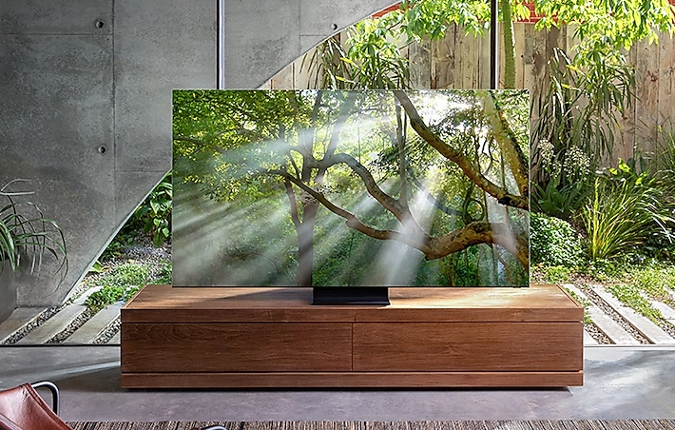
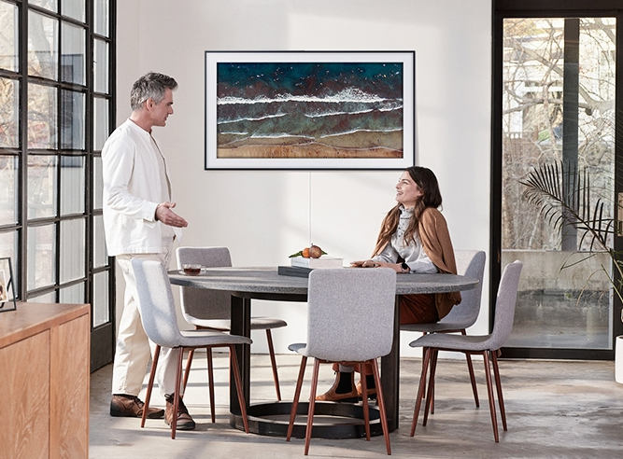
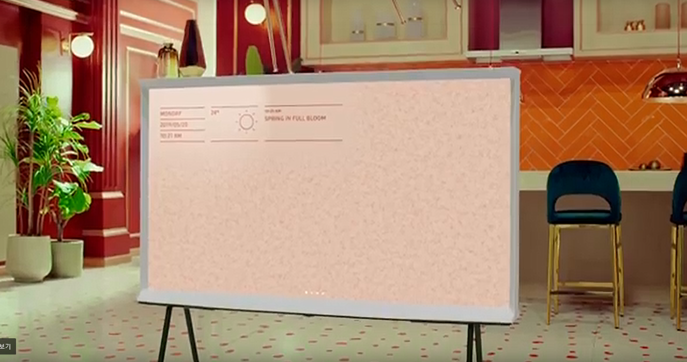
② Addition of Lifestyle TVs for Hospitality
Frame, Serif, 8K → Enables Package offering for the vertical
- Targeting Luxury , Boutique and Upper Scale hotels
- Not only Guestroom, also suitable to public area of Hotel (Lounge, Lobby, Dining)
QLED 8K “Flagship”
The Frame “Lifestyle”
Serif “Design TV”
* Managed by LYNK Cloud solution

Slide 4
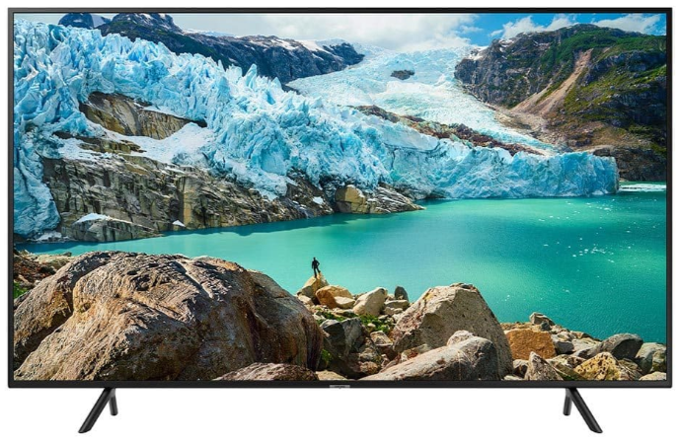
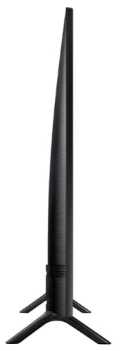
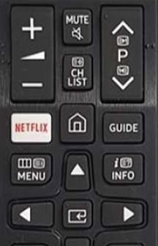
HTV Product Road map 2020
HRU750
43”, 50”, 55”, 65”, 75” Full UHD
2 Feet Simple Stand
Tizen 5.0
Advantages:
Netflix Smart App
LYNK Cloud Ready
UHD resolution
Depth : 61.2

Slide 5
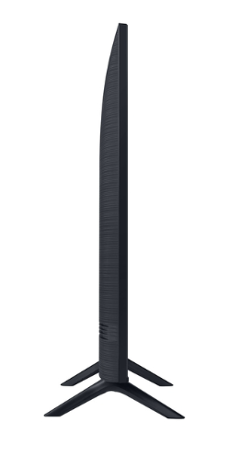
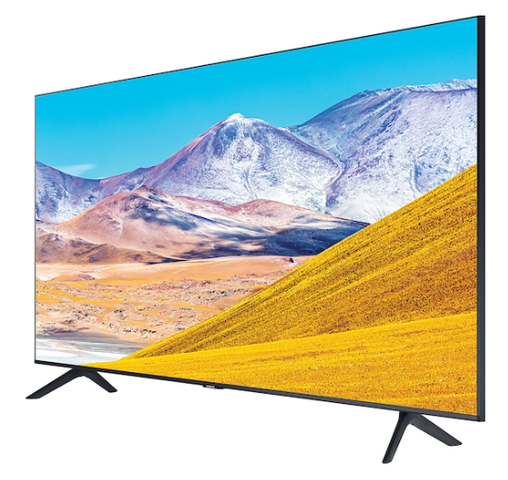
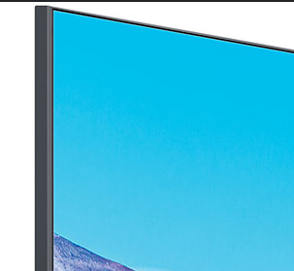
HTV Product Road map 2020
HT690U
43”, 50”, 55”, 65”, 75” Full UHD
43”, 50”, 55” : Swivel Stand
65”, 75” : Simple Stand
3 side bezeless design
5.5mm bezel
Advantages:
LYNK REACH Compatible
LYNK HBrowser Compatible
Lan-out port
UHD resolution with Bezel-less Design
Tizen 4.0 same as HF/HJ
Series (possible to mix the models)
Depth : 61.2

Slide 6
HTV Product Road map 2020
HTS030
43”, 50”, 55”, 65”, 75” Full UHD
Wall mount bracket included
Advantages:
LYNK Cloud Compatible
LYNK HBrowser Compatible ( Nov 2020)
UHD resolution with Bezel-less Design
Tizen 5.5 – new development will be needed
Wall mount bracket included in the package

