Slide 1
How to connect Datalink to Google Calendar

Slide 2
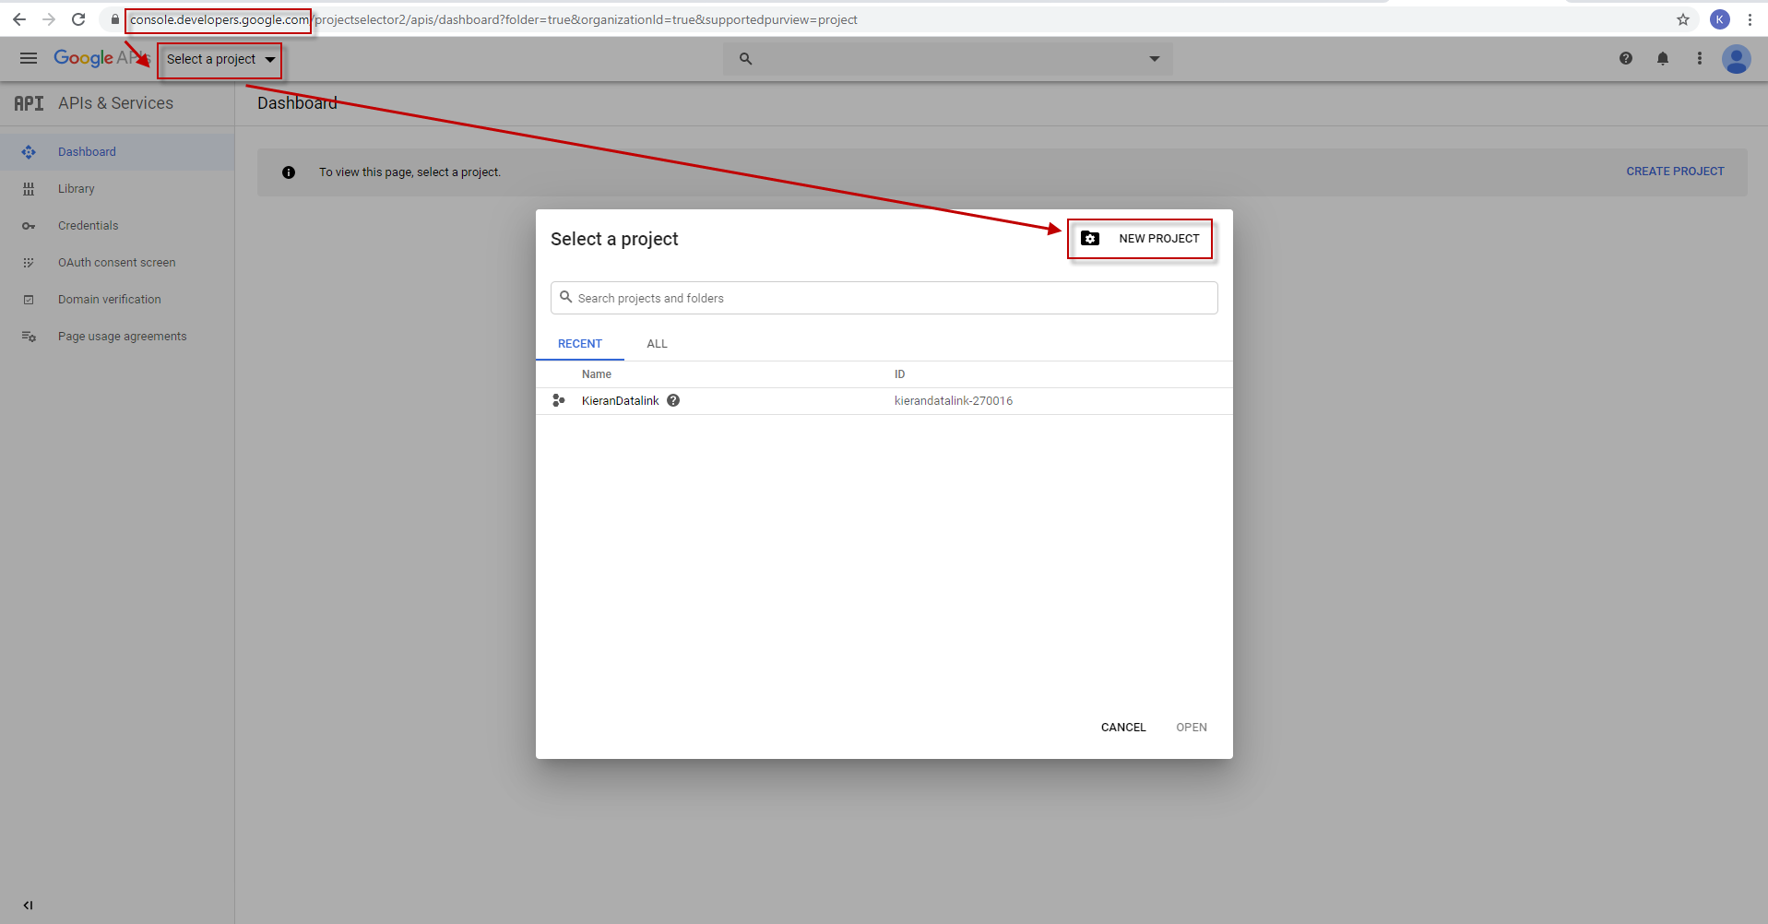
1. Create Project
Login Google account, access console.developers.google.com

Slide 3
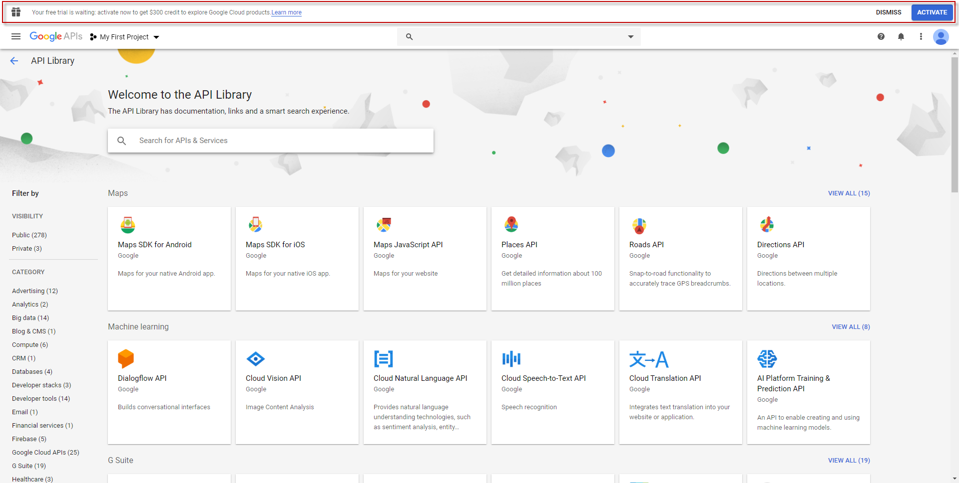
2. Activate Google Cloud

Slide 4
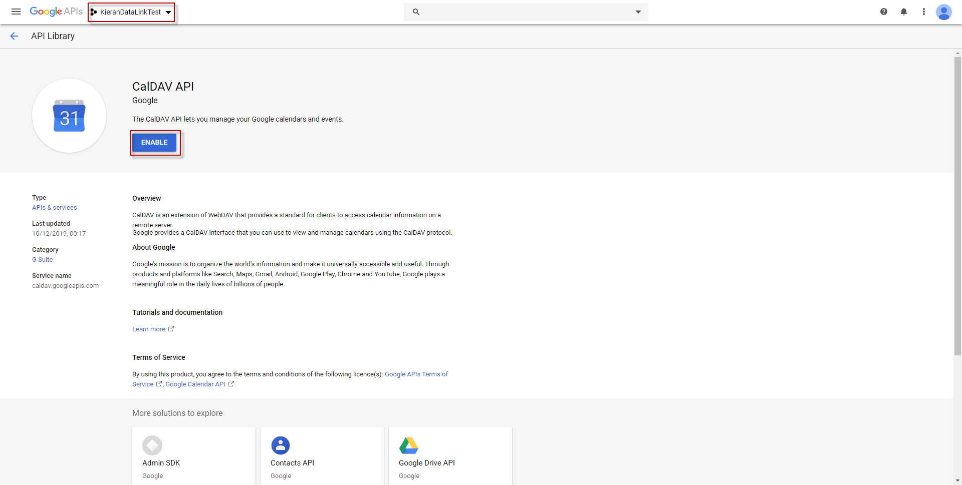
3. Enable APIs
Select Project
Enable 3 APIs
  CalDav API
  Calendar API
  Gmail API

Slide 5
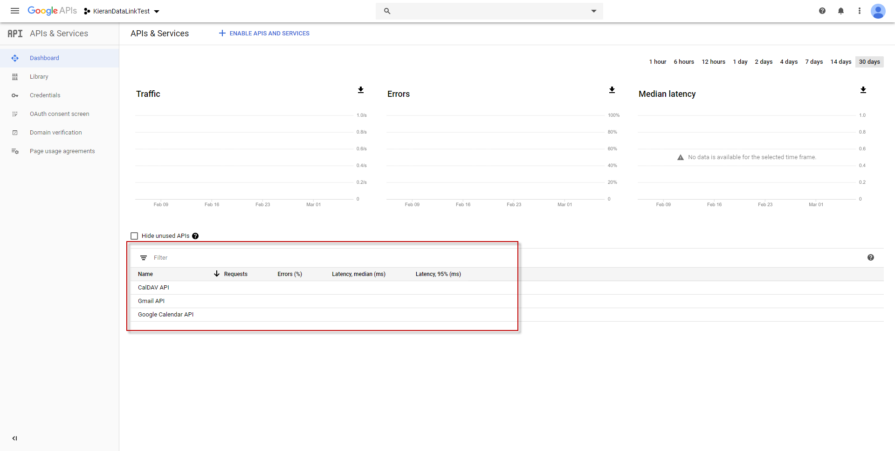
3-1. Check whether APIs are enabled.

Slide 6
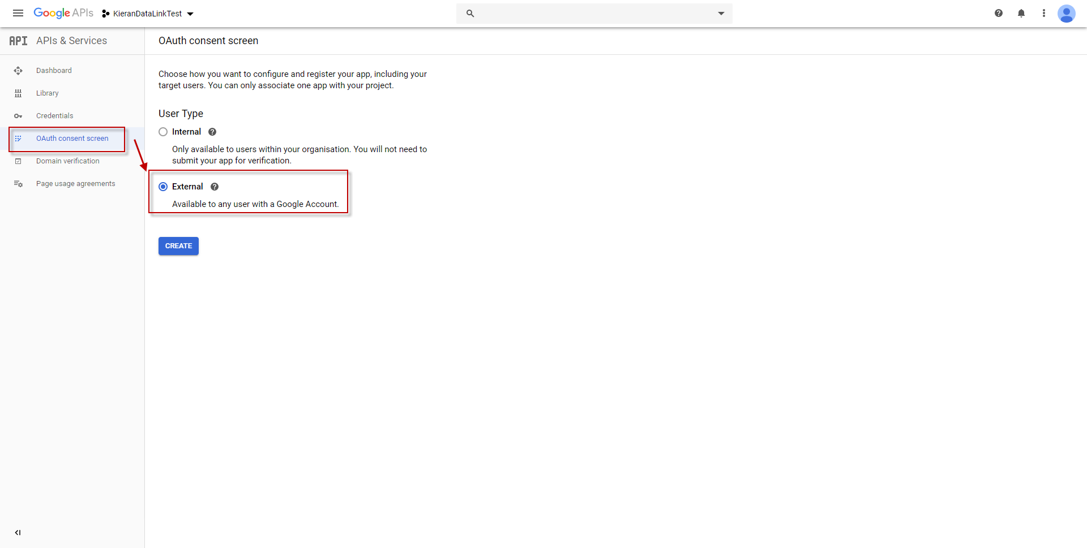
4. Create OAuth consent screen

Slide 7
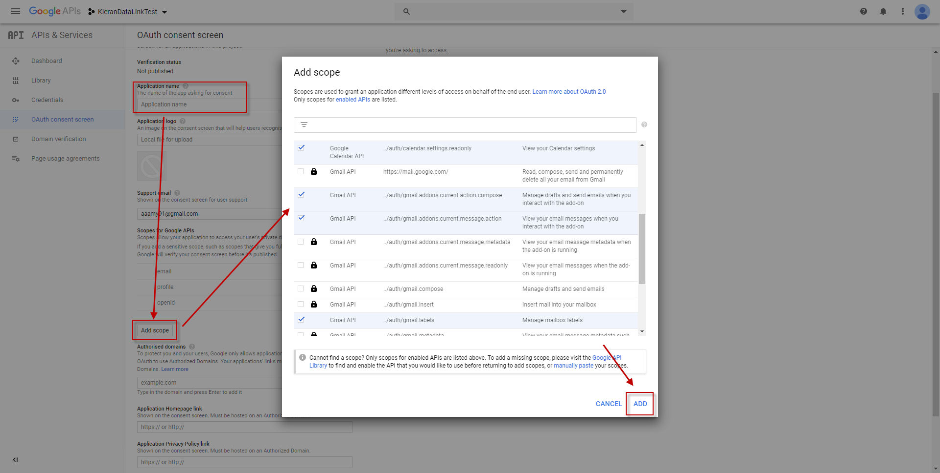
4. Create OAuth consent screen
Type Application name
Add scope
  Check all which
  doesn’t have lock icon.
Save

Slide 8
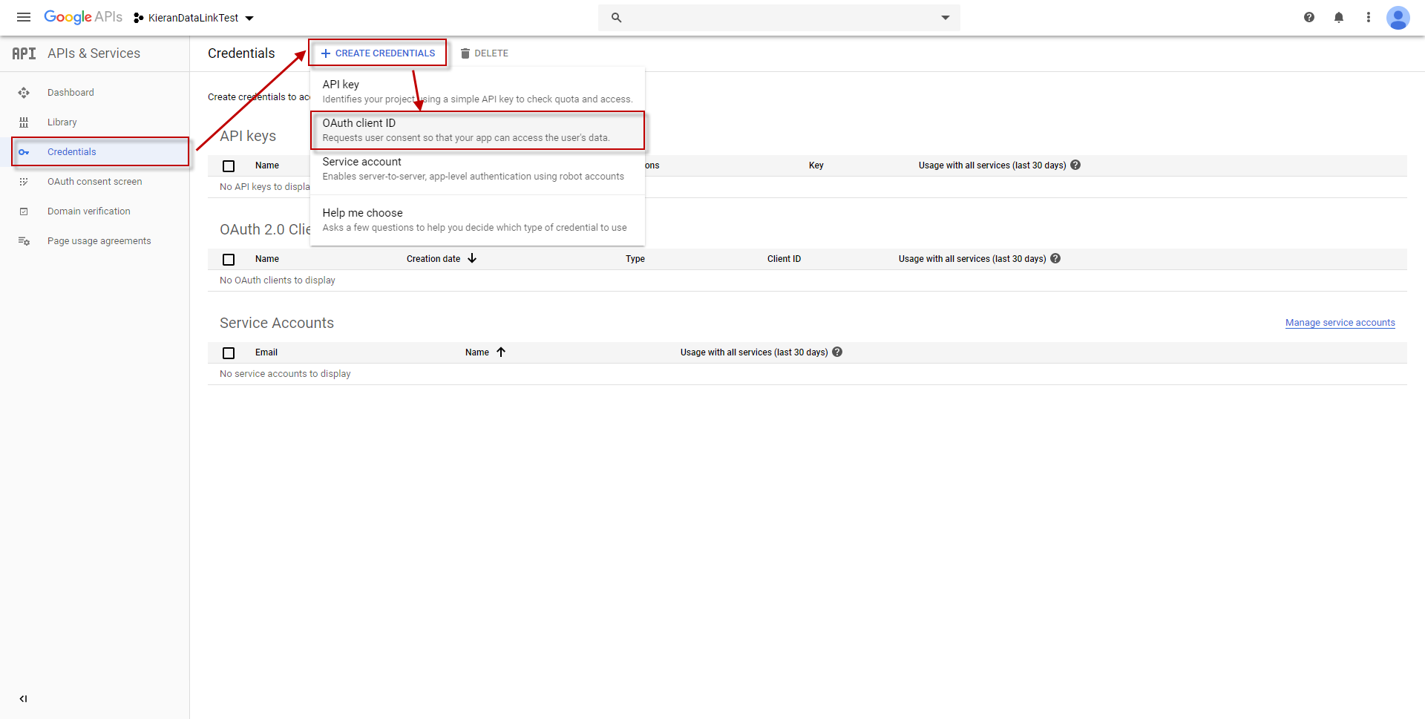
5. Create Credentials

Slide 9
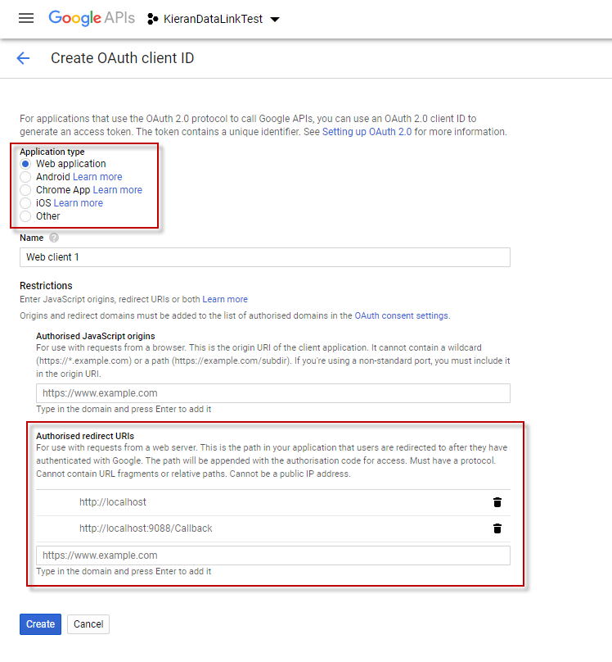
5. Create Credentials
Select “Web application”
Write redirect URIs
  http://localhost
  http://localhost:9088/Callback
Create

Slide 10
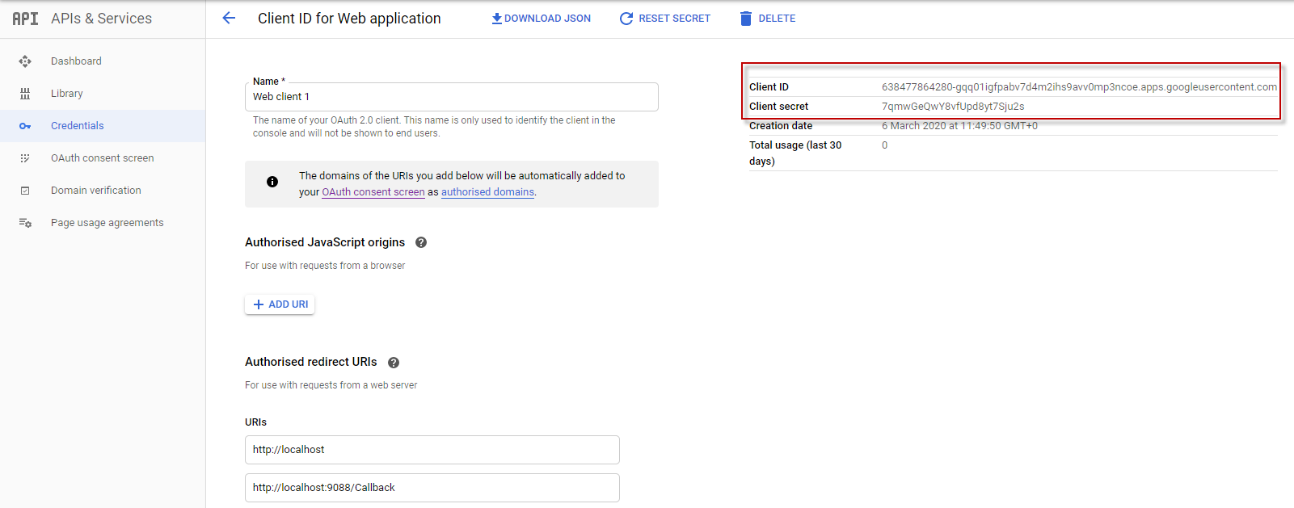
6. Get Client ID & PW, Accept your account
Access this link to accept your account :
https://accounts.google.com/o/oauth2/auth?access_type=offline&approval_prompt=force&client_id=ClientID&redirect_uri=http://localhost:9088/Callback&response_type=code&scope=https://www.googleapis.com/auth/calendar.readonly
Ex)
https://accounts.google.com/o/oauth2/auth?access_type=offline&approval_prompt=force&client_id=638477864280-gqq01igfpabv7d4m2ihs9avv0mp3ncoe.apps.googleusercontent.com&redirect_uri=http://localhost:9088/Callback&response_type=code&scope=https://www.googleapis.com/auth/calendar.readonly

Slide 11
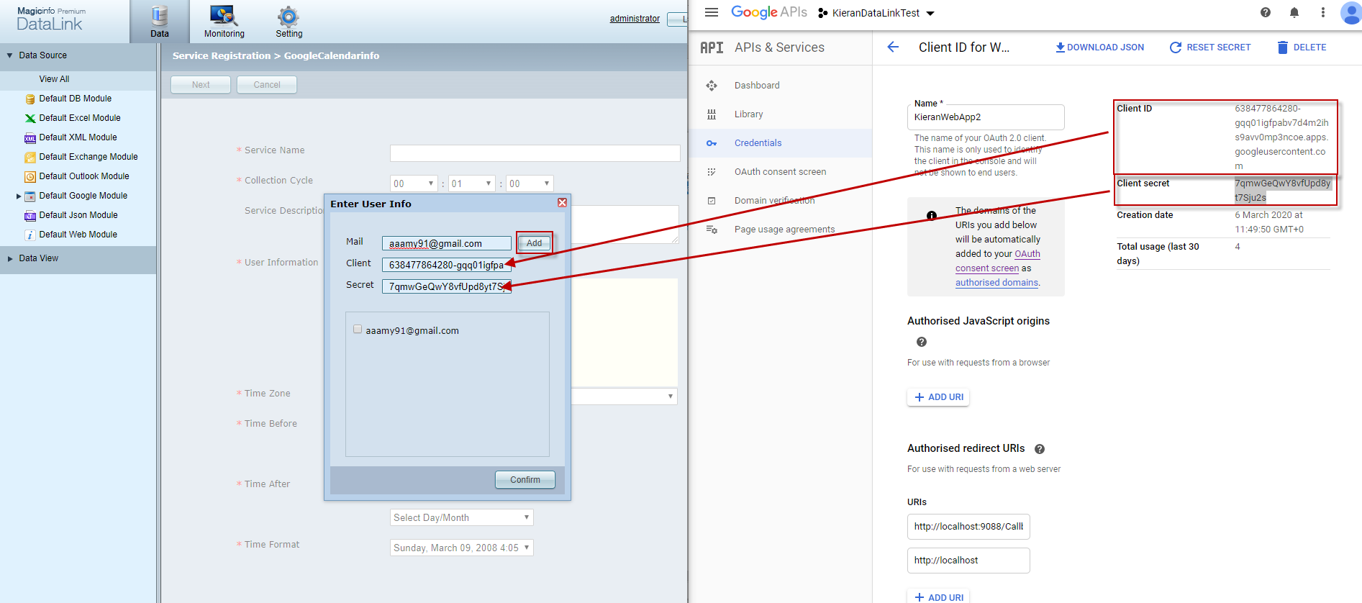
7. Add Google calendar

Slide 12
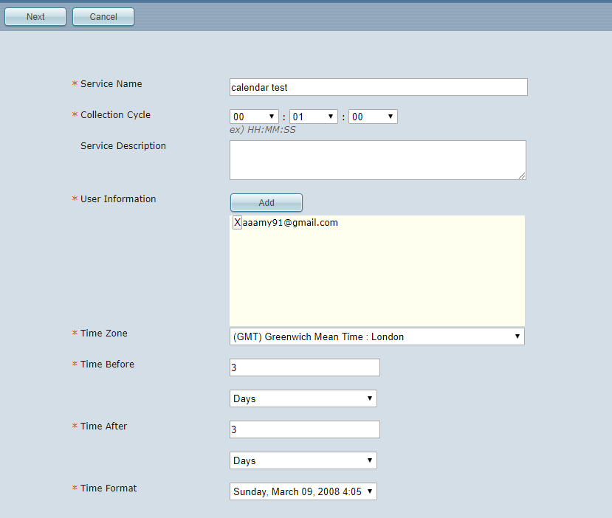
7. Add Google Calendar

Slide 13
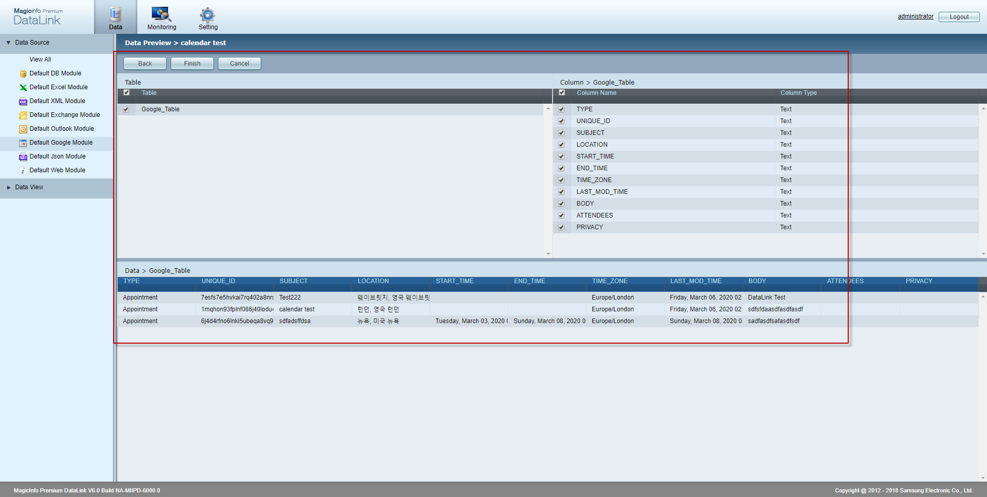
7. Add Google calendar

